Slide 1
Wireless Monitoring of Electrical parameters for NUS Smart Grid
Summer Internship at NUS, Singapore
By Subhajit Sahu

Slide 2
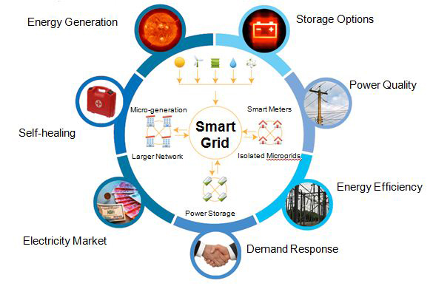
Smart Grid?

Slide 3

Why Smart Grid?

Slide 4
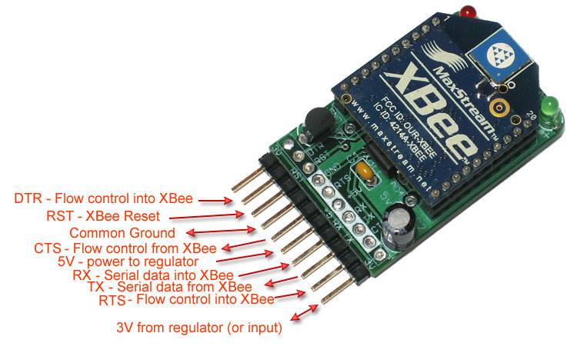
Xbee 802.15.4
Pin details of the XBee module

Slide 5
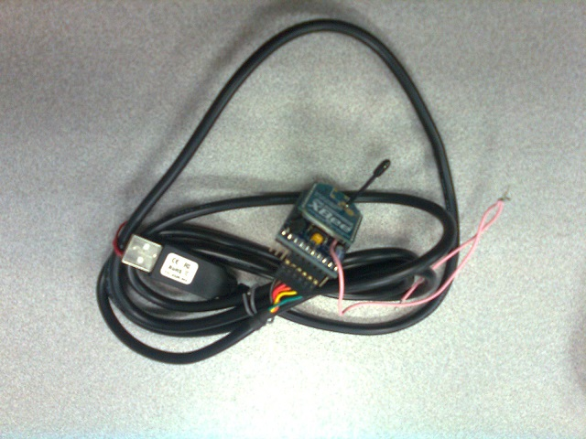
FTDI cable
FTDI cable to connect XBee to PC

Slide 6
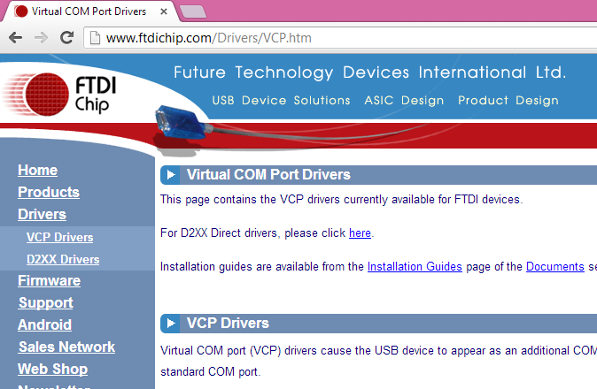
FTDI Driver
Virtual COM port driver

Slide 7
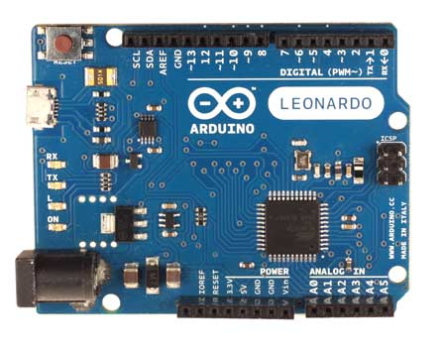
Arduino
Arduino Leonardo board: (used this originally for testing the Xbee module)

Slide 8
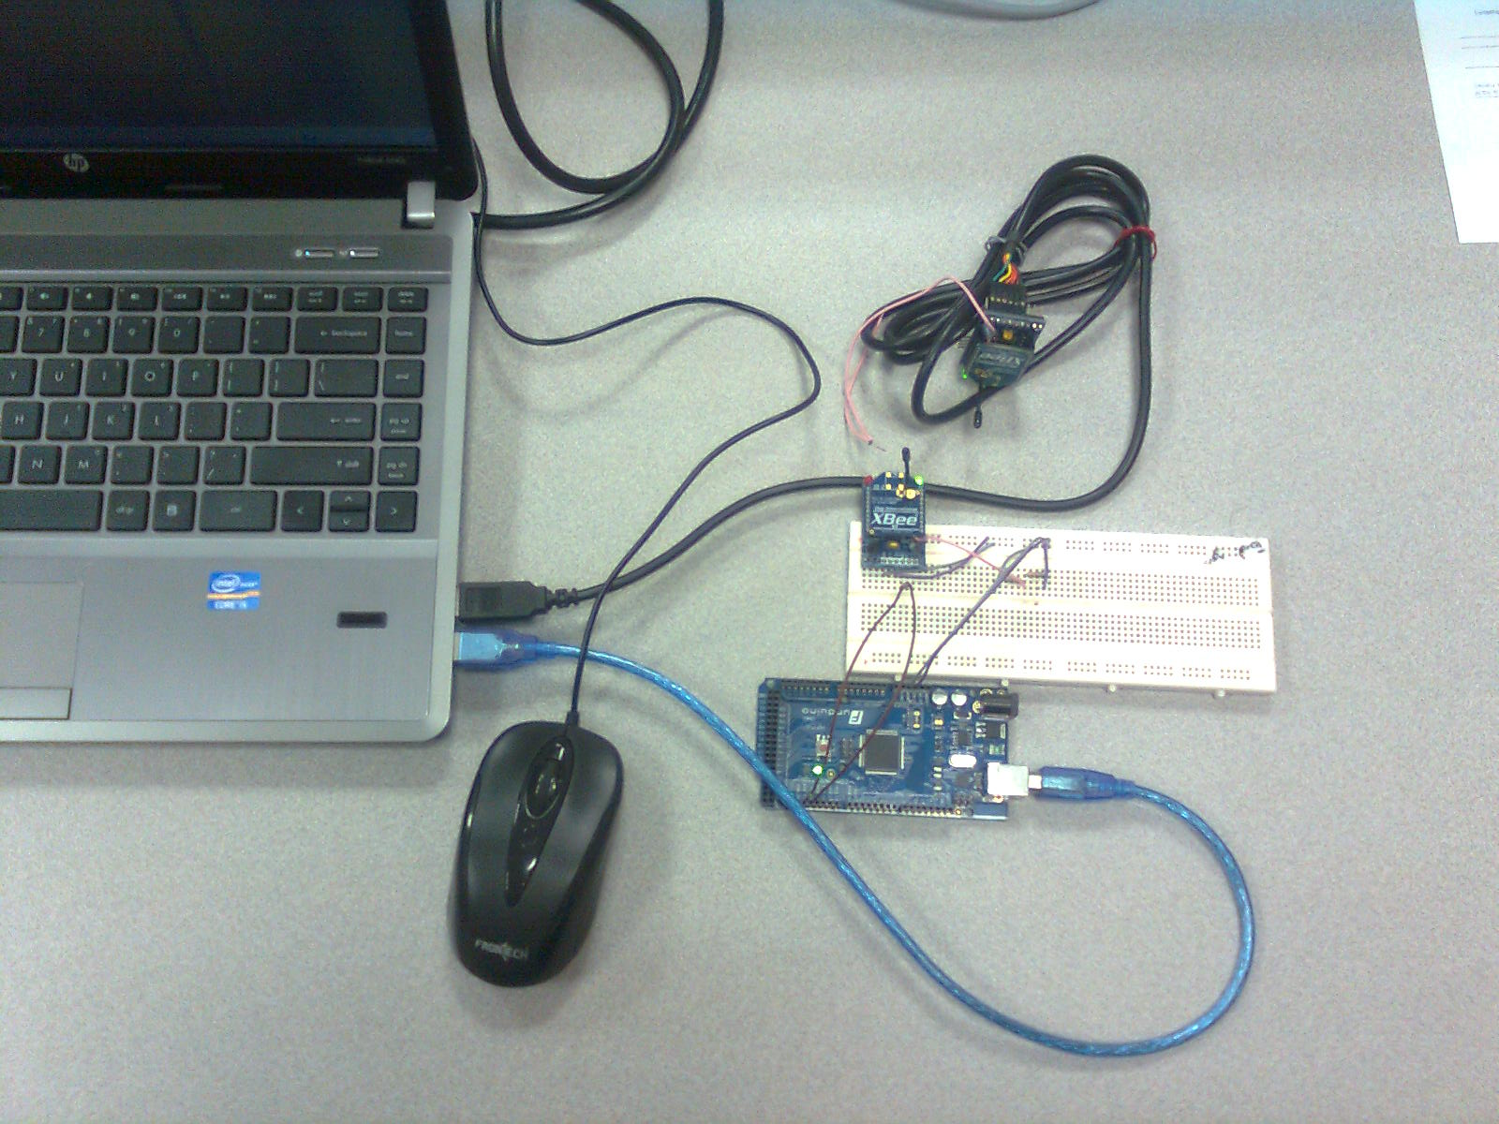
Setup for Xbee to Xbee Communication
Experimental setup for basic XBee to XBee communication

Slide 9
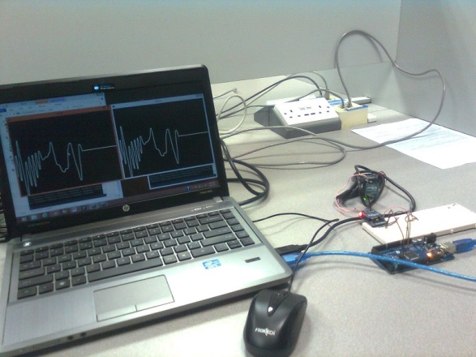
Xbee to Xbee Communication - Result
Sent and received signals (signals were generated manually using the PC)

Slide 10
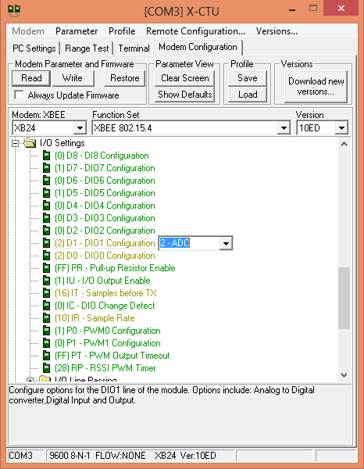
Configuring Xbee for Int. ADC Operation

Slide 11
XBee Packet Format (API)
Standard XBee packet example:
7E 00 1C 83 56 78 22 00 05 06 00 00 00 03 FF 00 00 03 FF 00 00 03 FF 00 00 03 FF 00 00 03 FF 77
Where the UART API data stream can be broken down as:

Slide 12
XBee Packet Format (API)
7E | Start Delimiter
00 1C | Length Bytes
83 | API Identifier Byte for 16bit A/D data (82 is for 64bit A/D data)
56 78 | Source Address Bytes
22 | RSSI Value Bytes
00 | Option Byte
05 | Sample Quantity Byte
06 00 | 00000110 00000000 Channel Indicator *
00 00 | Sample Data ADC0 (min value for A/D is 00 00)
03 FF | Sample Data ADC1 (max value for A/D is 03 FF, indicating the value of ADC1 is Vref)
77 | Check Sum

Slide 13
XBee Packet Format (API)
MSB = 0x06 |  | LSB = 0x00
0 | 0 | 0 | 0 | 0 | 1 | 1 | 0 | 0 | 0 | 0 | 0 | 0 | 0 | 0 | 0
NA | A5 | A4 | A3 | A2 | A1 | A0 | D8 | D7 | D6 | D5 | D4 | D3 | D2 | D1 | D0

Slide 14
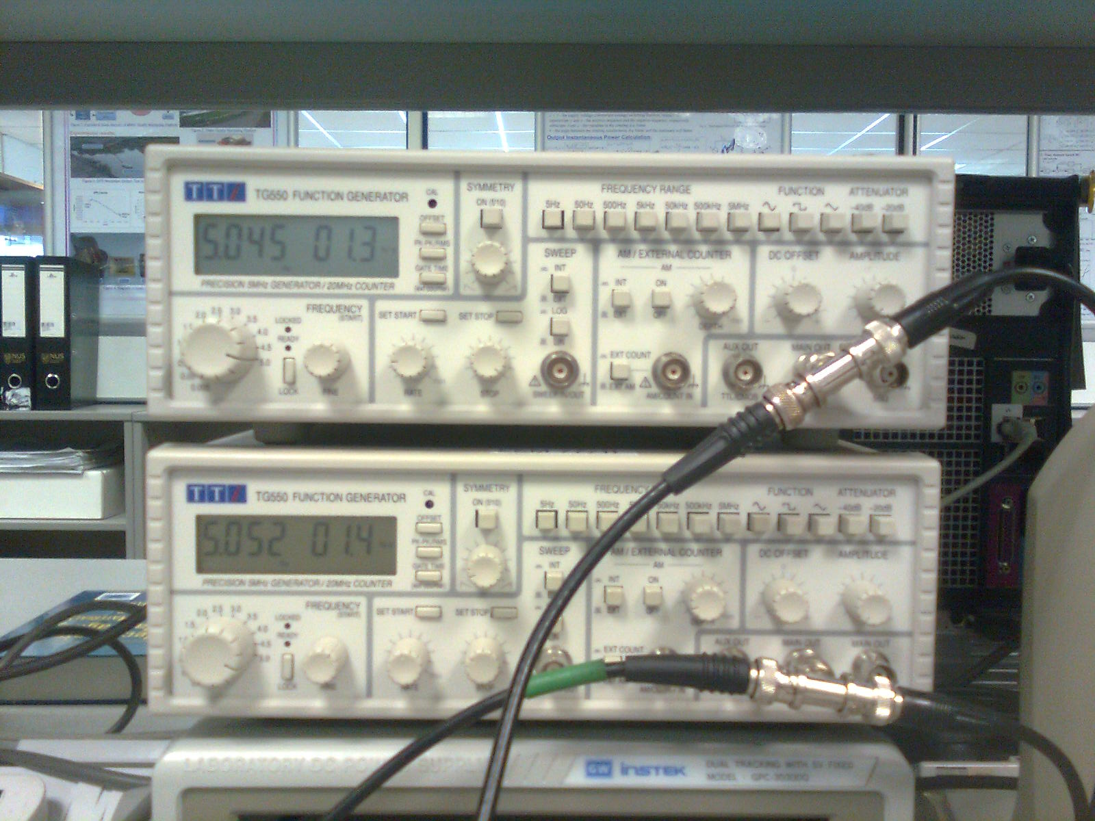
Setup for Signal Monitoring with XBee Internal ADC
Two function generators being used to generate 2 unipolar signals to be measured

Slide 15
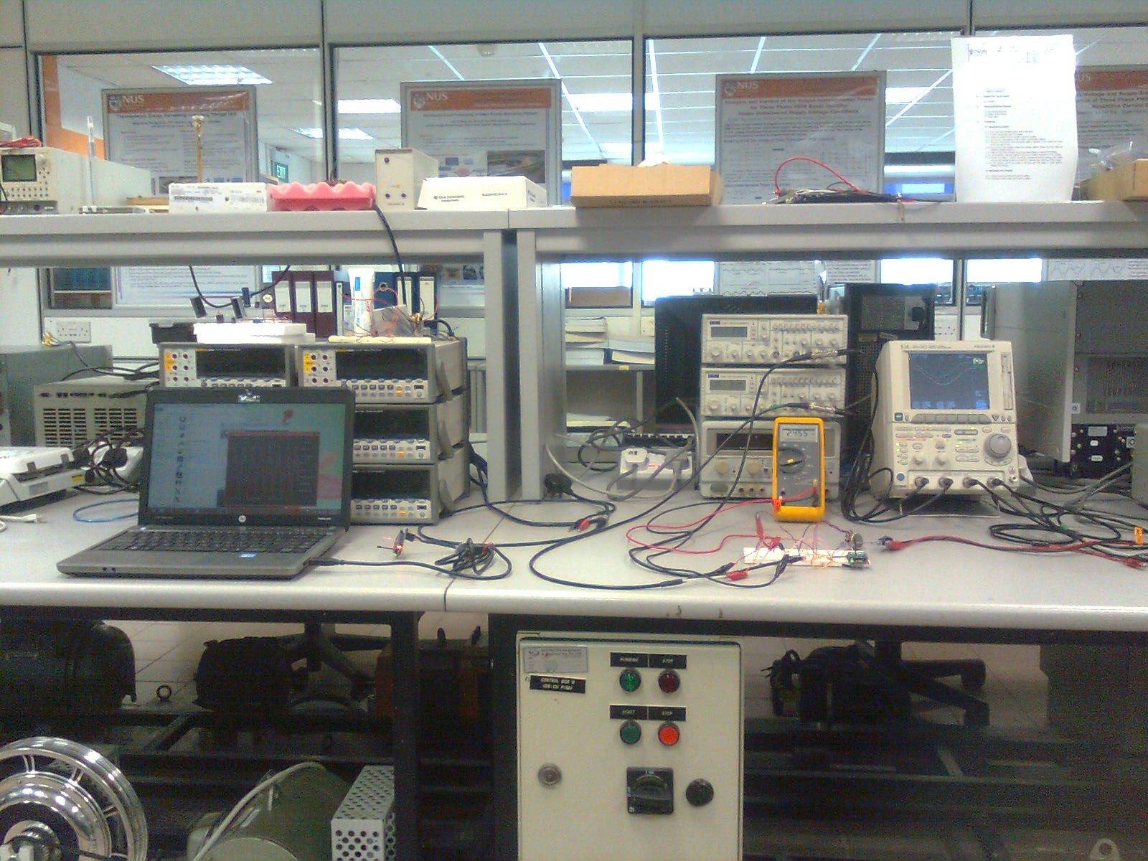
Setup for Signal Monitoring with XBee Internal ADC
Experimental setup for capturing 2 unipolar analog signals using in-built ADC present in XBee

Slide 16
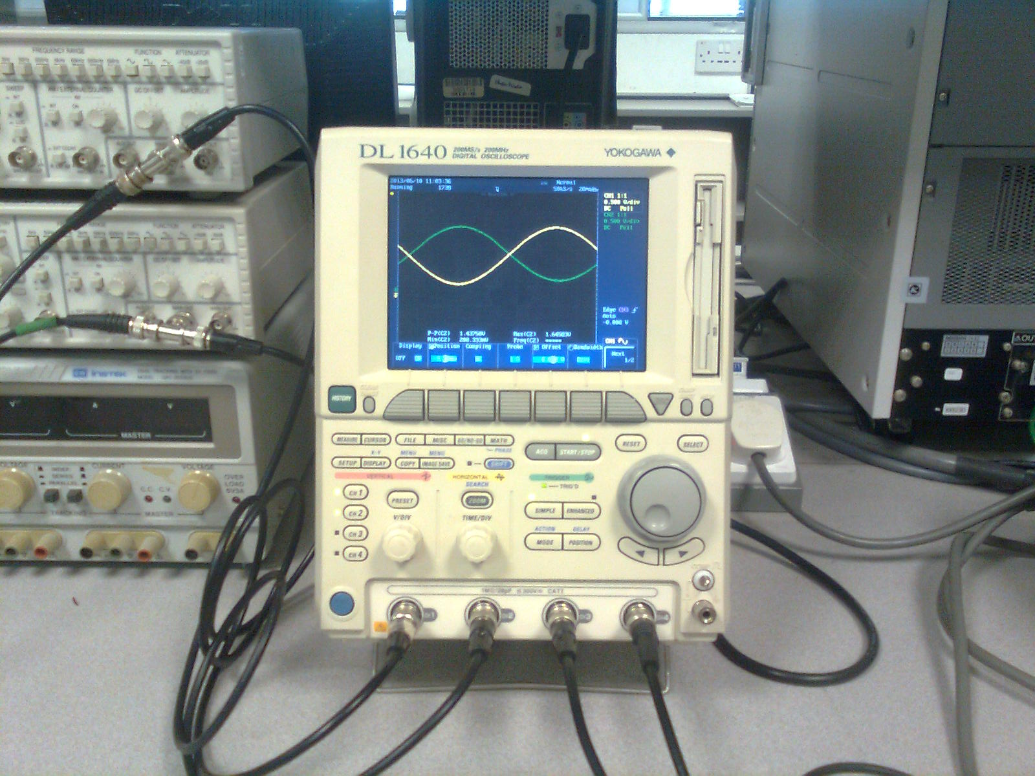
Setup for Signal Monitoring with XBee Internal ADC
2 unipolar analog signals being displayed on an oscilloscope

Slide 17
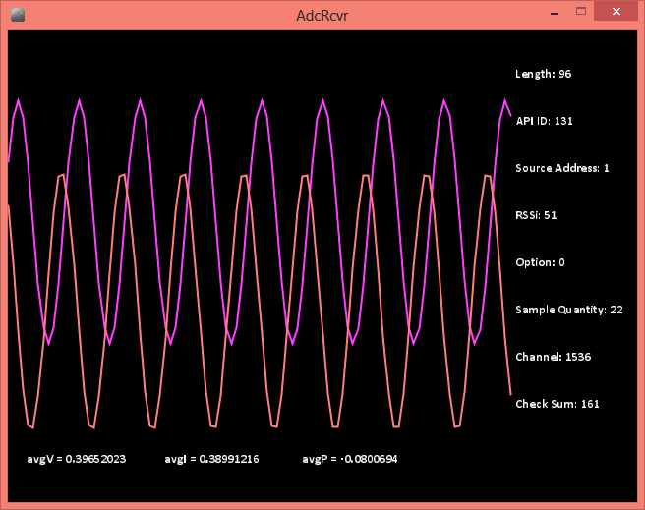
Signal Monitoring with XBee Internal ADC - Result
Received and decoded analog signals received on PC using the developed ADC receiver program (using Processing) at around 160sps

Slide 18
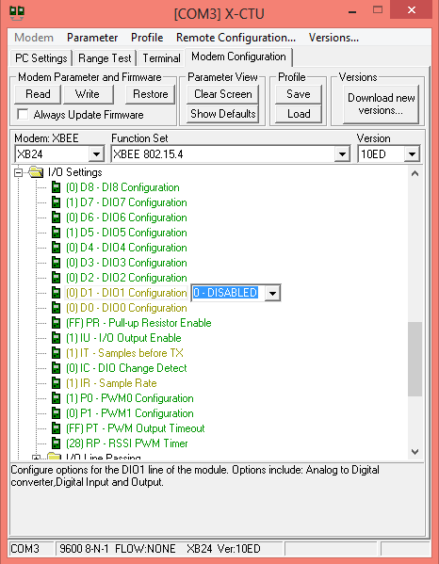
Configuring Xbee for Wireless Tx

Slide 19
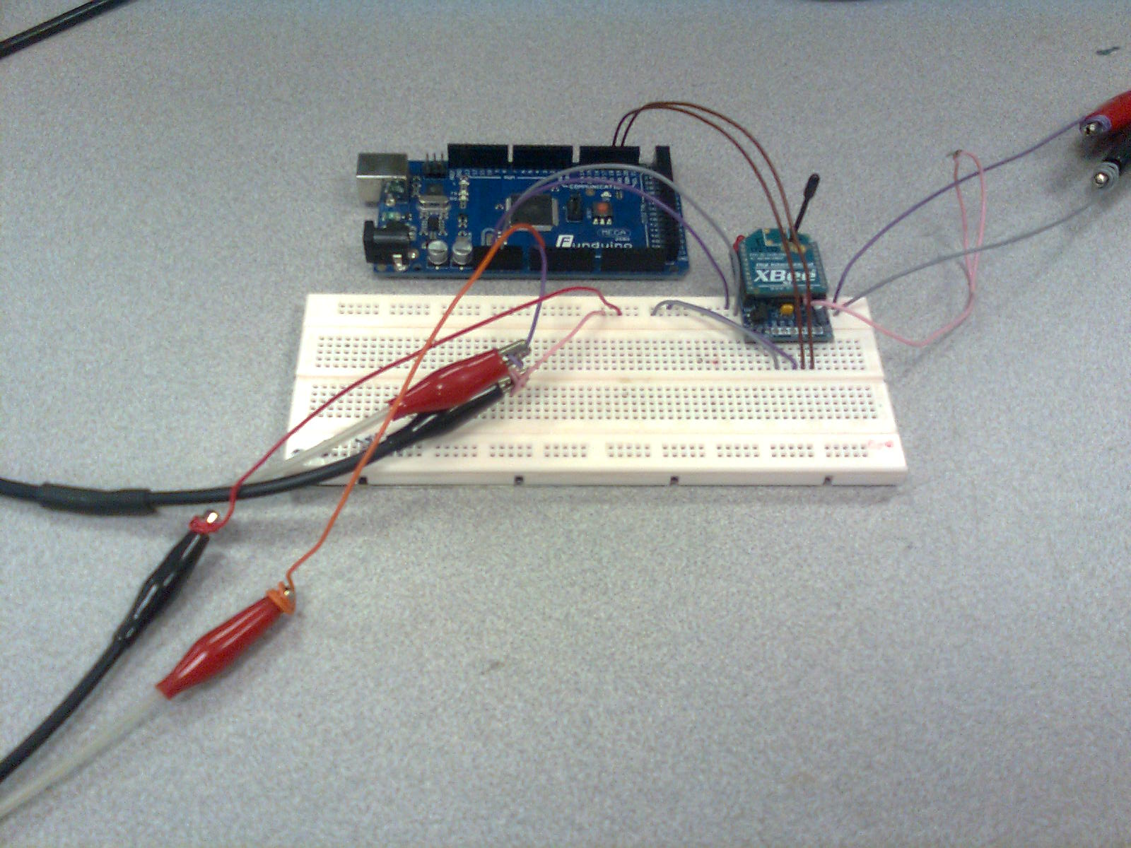
Setup for Measuring Unipolar Signals
Experimental setup for sending unipolar analog signals to PC using Arduino

Slide 20
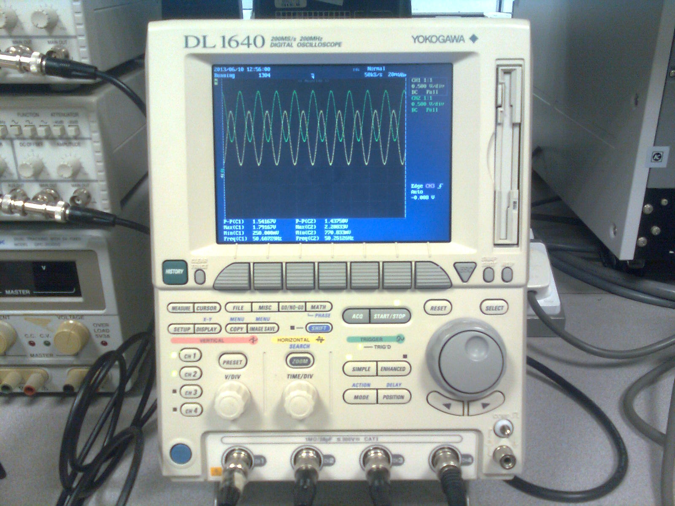
Setup for Measuring Unipolar Signals
Original analog signals being sent by Arduino on oscilloscope

Slide 21
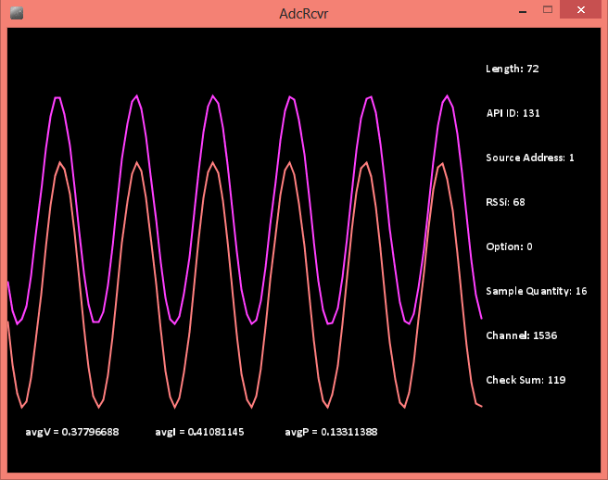
Measuring Unipolar Signals - Result
Received and decoded analog signals on PC with a sampling rate of around 1ksps

Slide 22
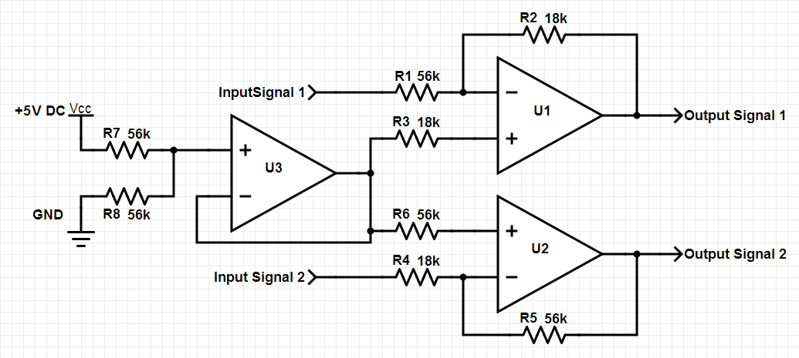
Signal Conditioning Circuit for Measuring Bipolar Signals
Signal conditioning circuit designed to convert bipolar signals to unipolar signal centered at 2.5V and with scaling factors of 18/56 and 56/18 for signals 1 and 2 respectively

Slide 23
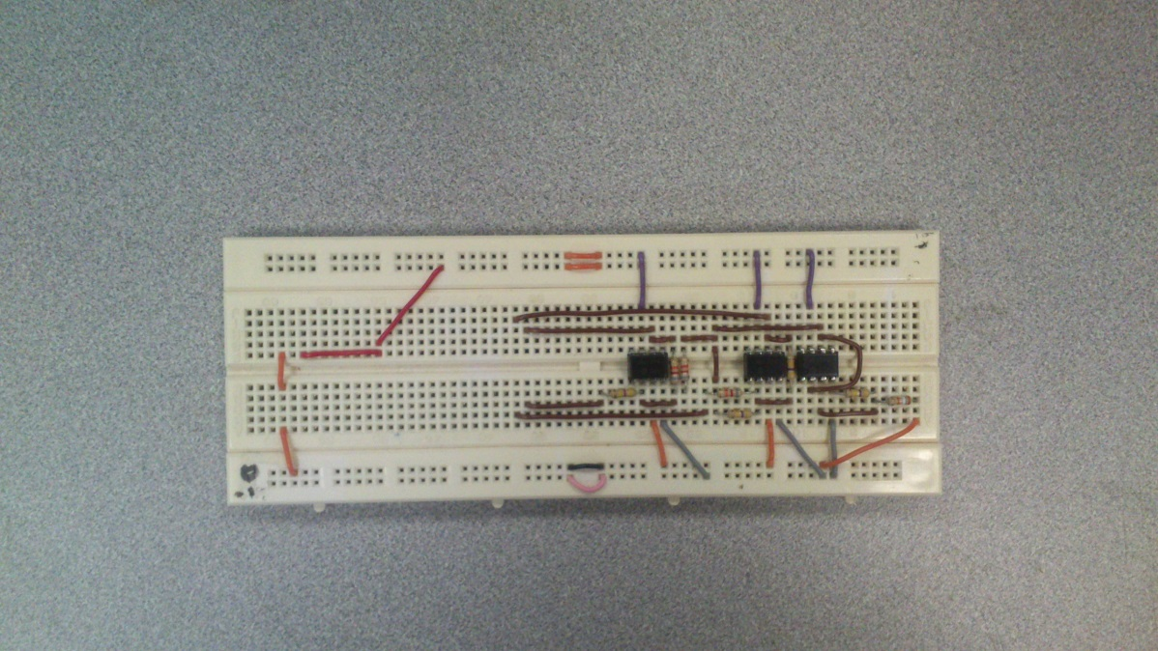
Signal Conditioning Circuit for Measuring Bipolar Signals

Slide 24
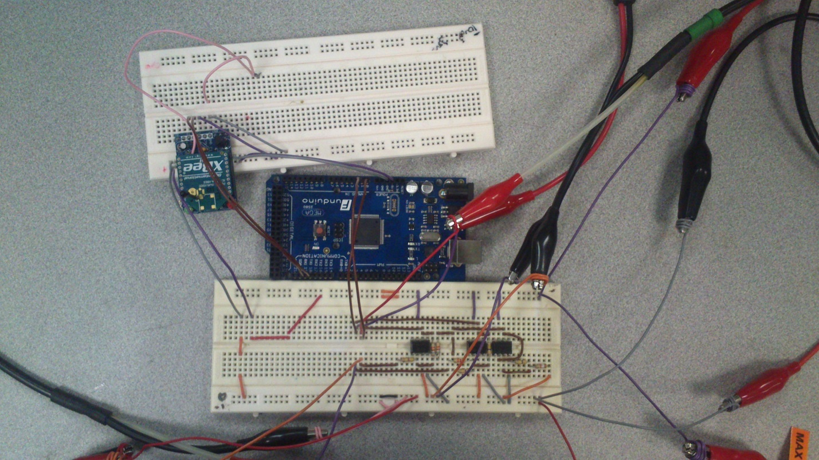
Setup for Measuring Bipolar Signals
Experimental setup for capturing 2 bipolar analog signals using signal conditioning circuit and Arduino

Slide 25
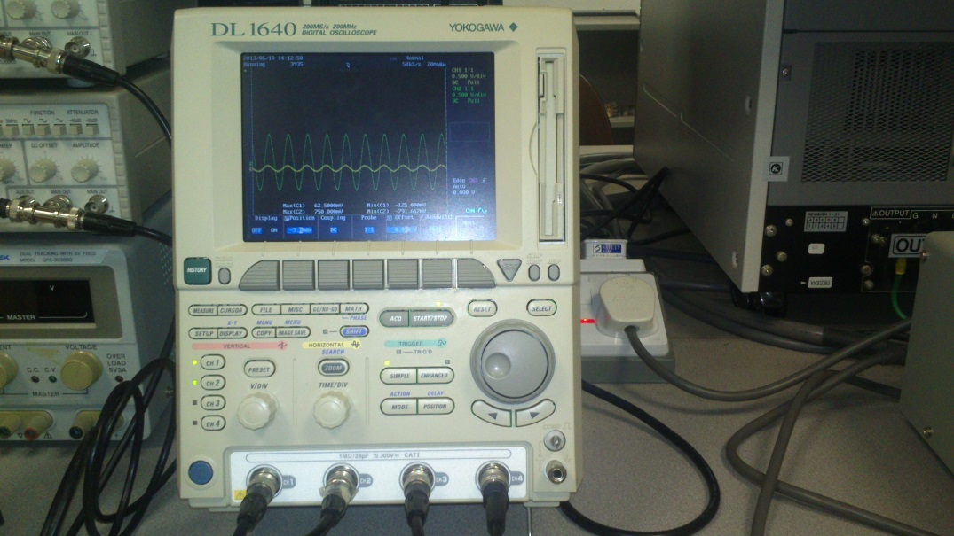
Setup for Measuring Bipolar Signals
2 bipolar analog signals being displayed on an oscilloscope

Slide 26
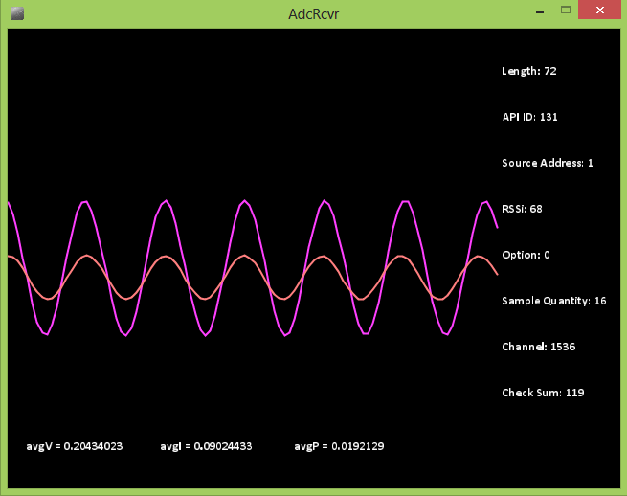
Measuring Bipolar Signals - Result
Received and decoded analog signals received on PC using the developed ADC receiver program (using Processing) at around 1ksps

Slide 27
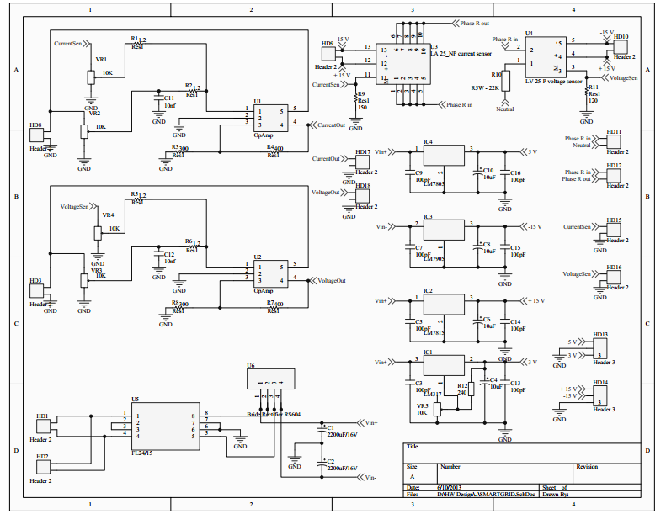
Voltage and Current Sensing Circuit

Slide 28
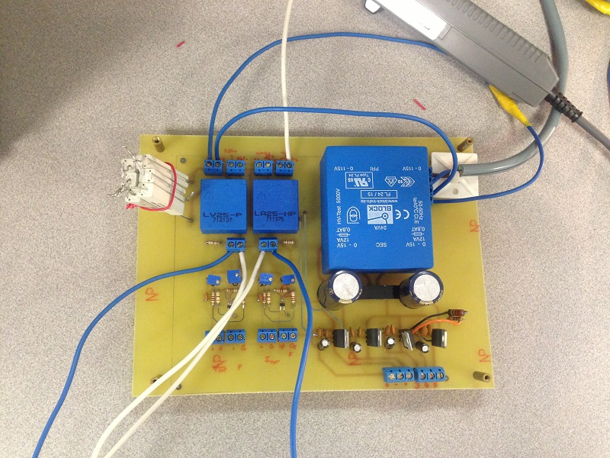
Voltage and Current Sensing Circuit

Slide 29
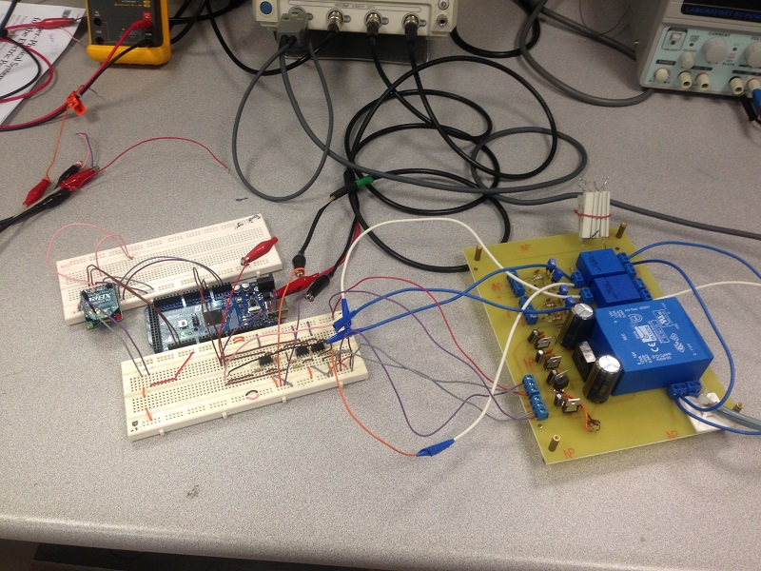
Setup for Voltage and Current Sensing

Slide 30
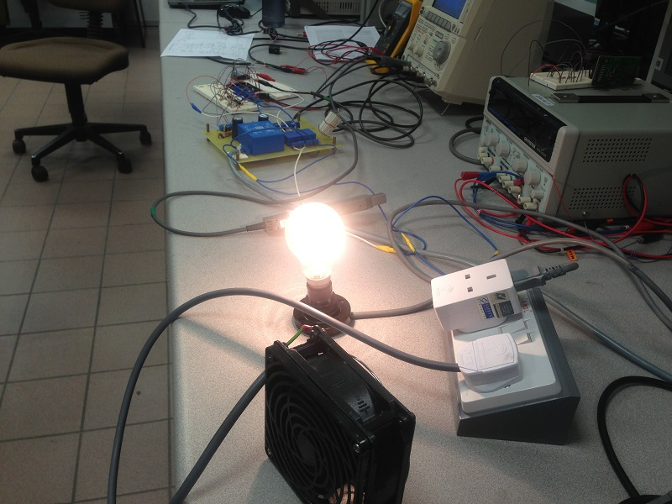
Setup for Voltage and Current Sensing
Loads connected to the socket of the Voltage and Current sensing circuit

Slide 31
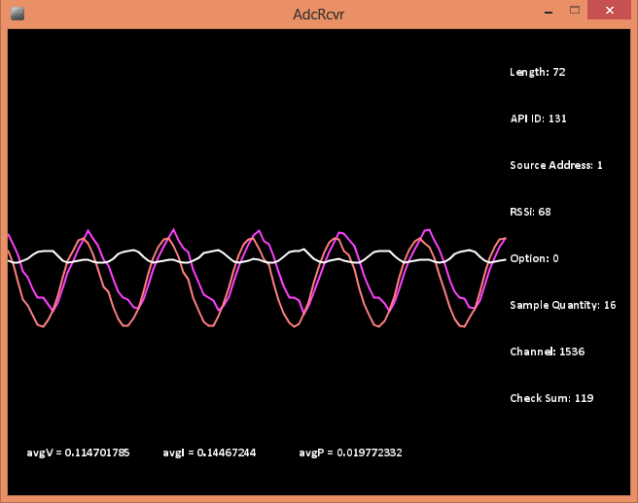
Voltage and Current Sensing Result
Received and decoded voltage and current sensing output received on PC using the developed ADC receiver program (using Processing) at around 1ksps

Slide 32
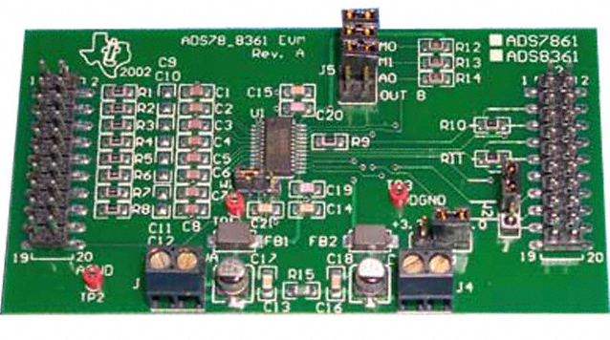
Measurement from a Simultaneous sampling External ADC
ADS8361 EVM board is a high-speed simultaneous sampling ADC board that supports sampling rate up to 500ksps, and can be interface with SPI protocol

Slide 33
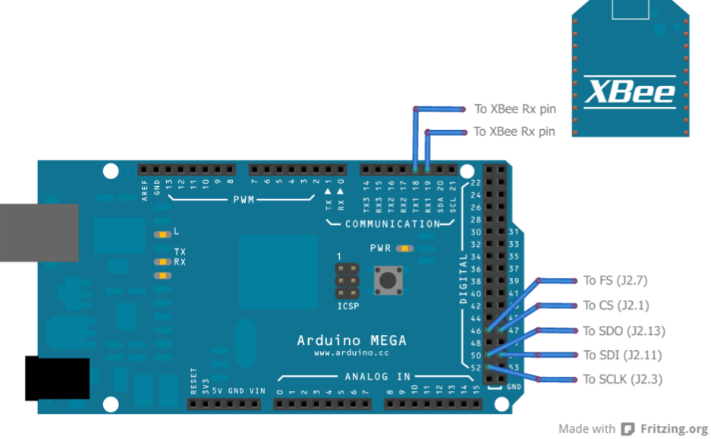
Connections from Arduino
Connections to be made between Arduino Mega and the ADS8361 EVM board

Slide 34
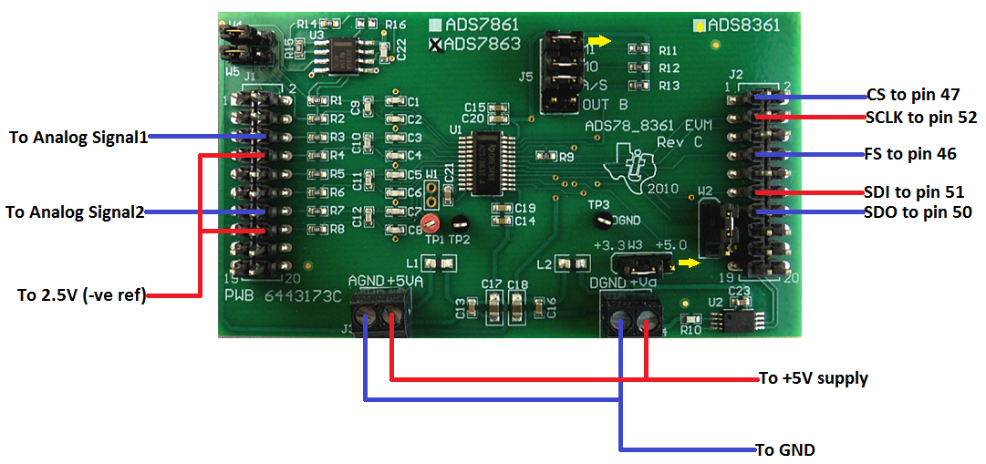
Connections from Ext. ADC
Connections to be made to ADS8361 EVM board

Slide 35
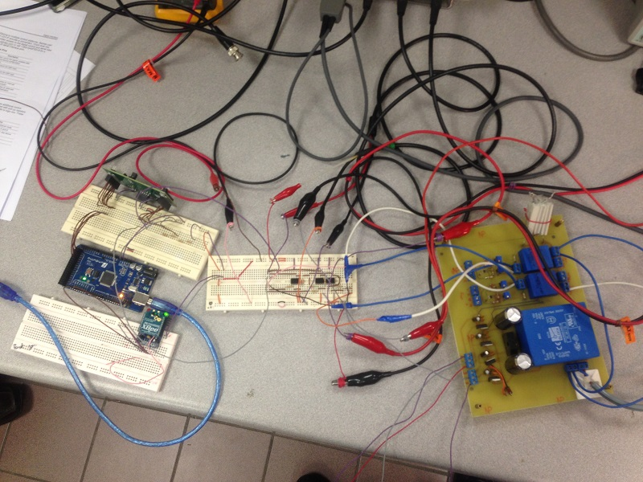
Ext. ADC Measurement Setup

Slide 36
Ext. ADC Measurement Setup
Loads connected to the socket of the Voltage and Current sensing circuit

Slide 37
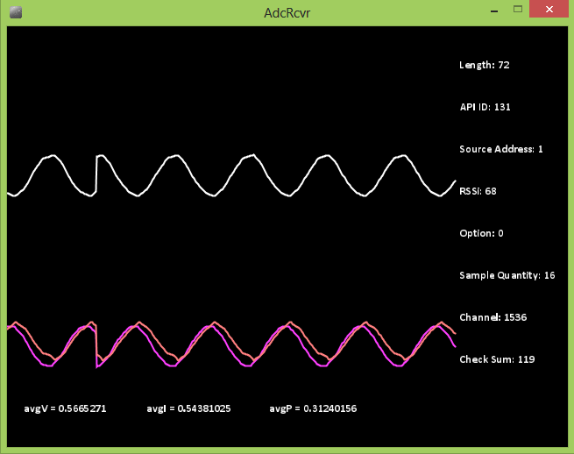
Ext. ADC Measurement Result
Received and decoded voltage and current sensing output received on PC using the developed ADC receiver program (using Processing) at around 12.5ksps

Slide 38
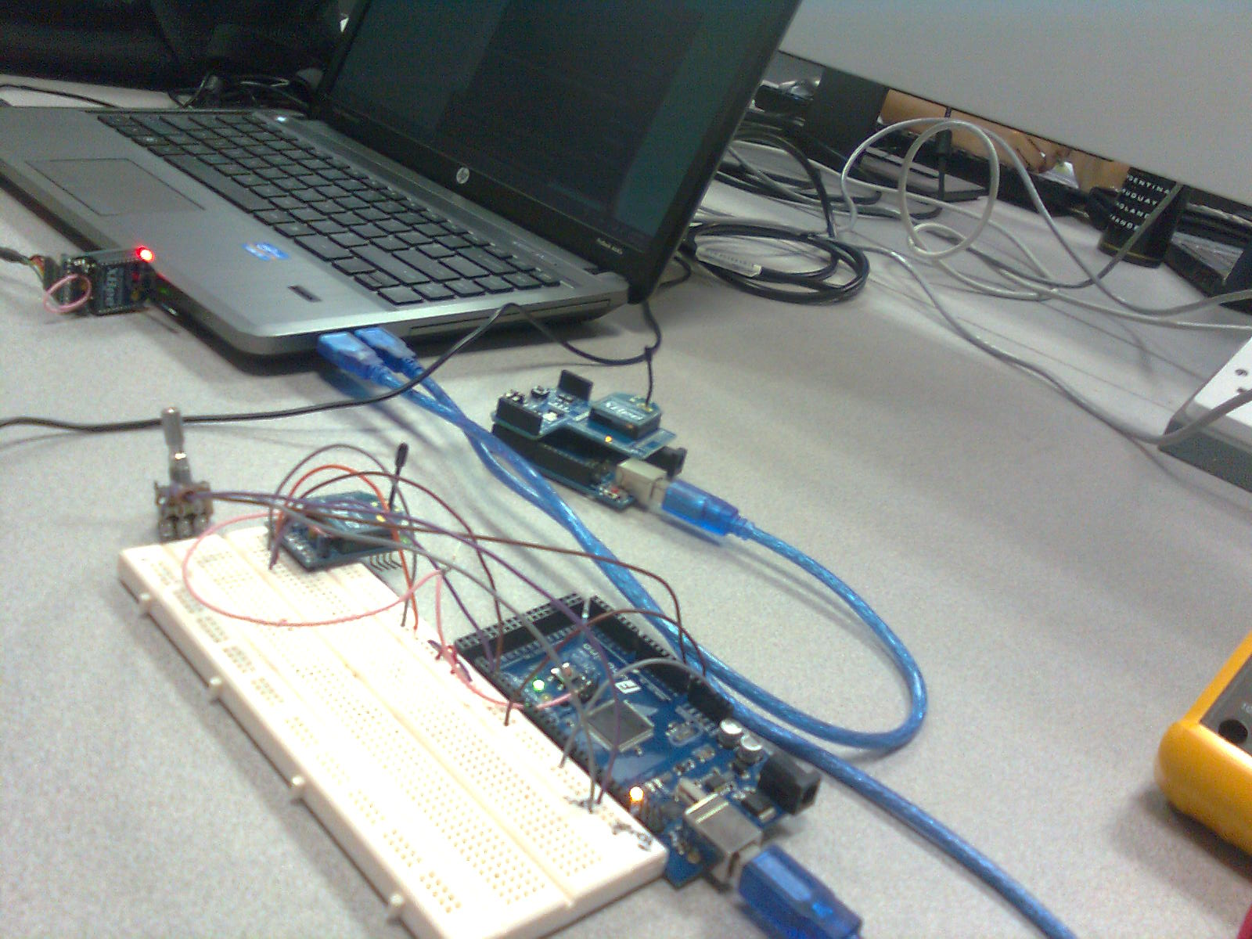
Multi-Node Test Setup
Experimental setup for capturing analog signals from 2 different nodes and display it on the PC

Slide 39
Xbee API Test
XBee API mode is being used to send data from one XBee module to another.
This mode allows data to be transmitted in form of RF packets, as well as provides additional information such as packet reception status.
The reception status can be seen on the COM3 X-CTU window (left) which is shown in red color.

Slide 40
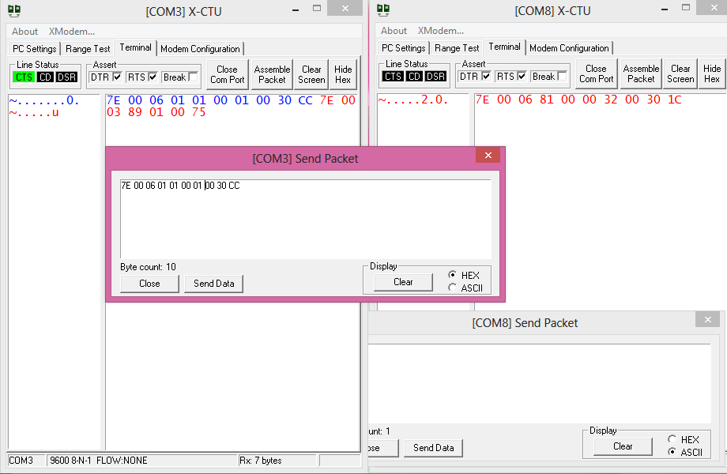
Xbee API Test

Slide 41
Multi-Node Data Reception - Result
Four signals being received from 2 nodes and being displayed on the PC.
The PC is connected to one XBee module and receives data from the nodes in alternating fashion.

Slide 42
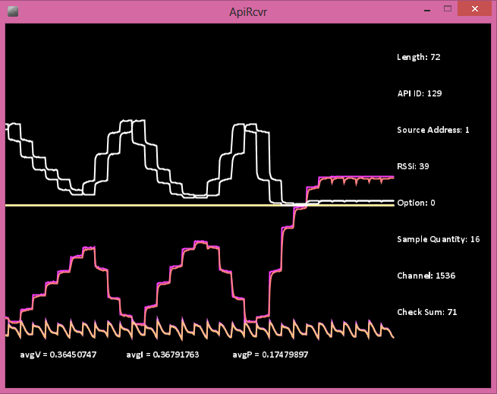
Multi-Node Data Reception - Result

Slide 43
Spectrum Test Setup
Experimental setup for sensing voltage and current used on a socket using the voltage and current sensing board along with the signal conditioning circuit and Arduino.
The captured samples were sent to through Xbee to a base station connected to Xbee which received the samples and stored it in a text file.
The samples stored in the text file was then used in MATLAB to obtain the spectrum of voltage and current samples captured.

Slide 44

Spectrum Test Setup

Slide 45
Spectrum Test Setup
Loads connected to the socket (which was connected to voltage and current transducer) were changed (turned on and off) in certain amount of time.
A bulb and a CPU fan (shown in this picture) were used as loads, which were turned on and off).
This was done in order to see the effect of harmonics introduced in the supply when loads were changed.
The voltage and current transducer board which captures the signals is on the top of the picture.

Slide 46

Spectrum Test Setup

Slide 47
MATLAB Recording
The AC voltage and current samples that were captured by the microcontroller plotted in this figure, using MATLAB.
DC Offset in the signals were removed and they were scaled to appropriate values.
The spectrum of both the signals was then plotted to observe the frequencies of noise introduced in the waveforms due to load switching.

Slide 48
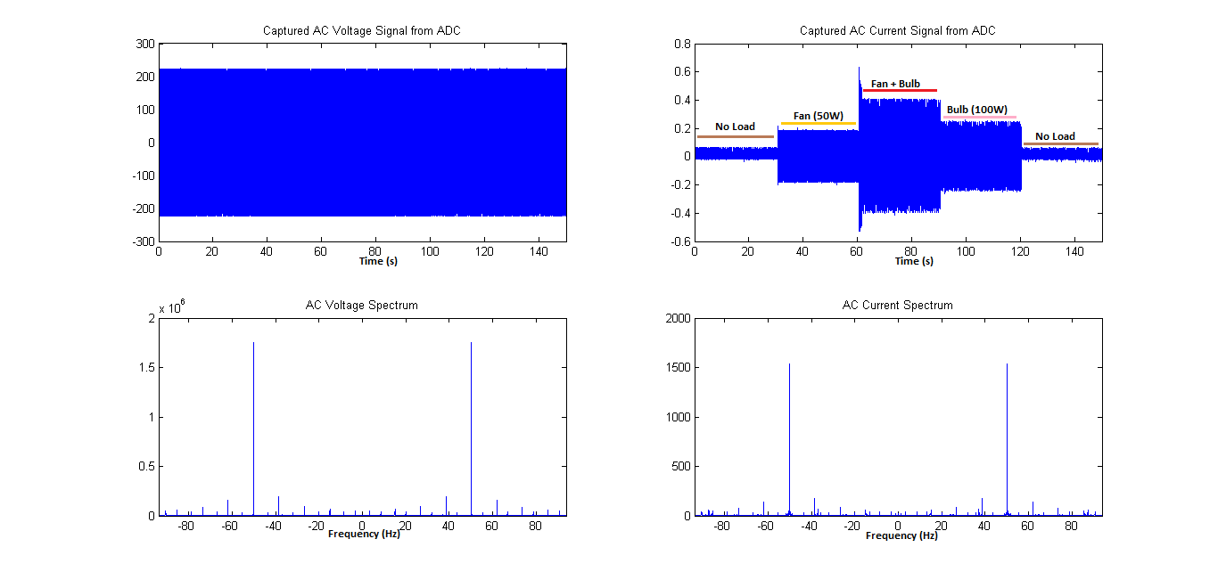
MATLAB Recording

Slide 49
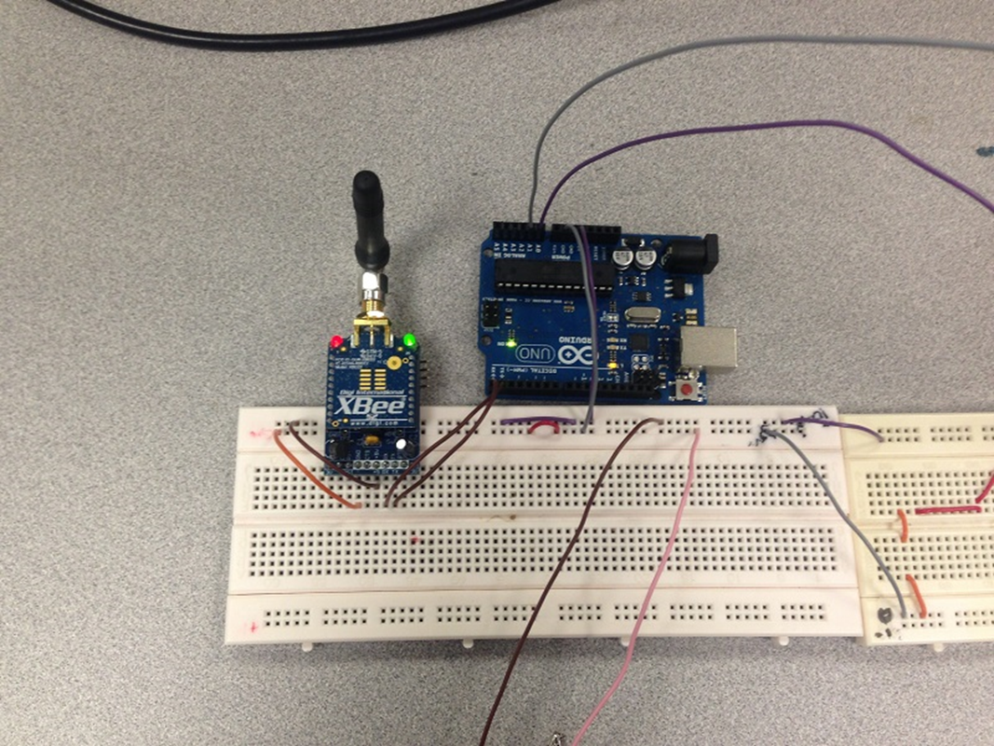
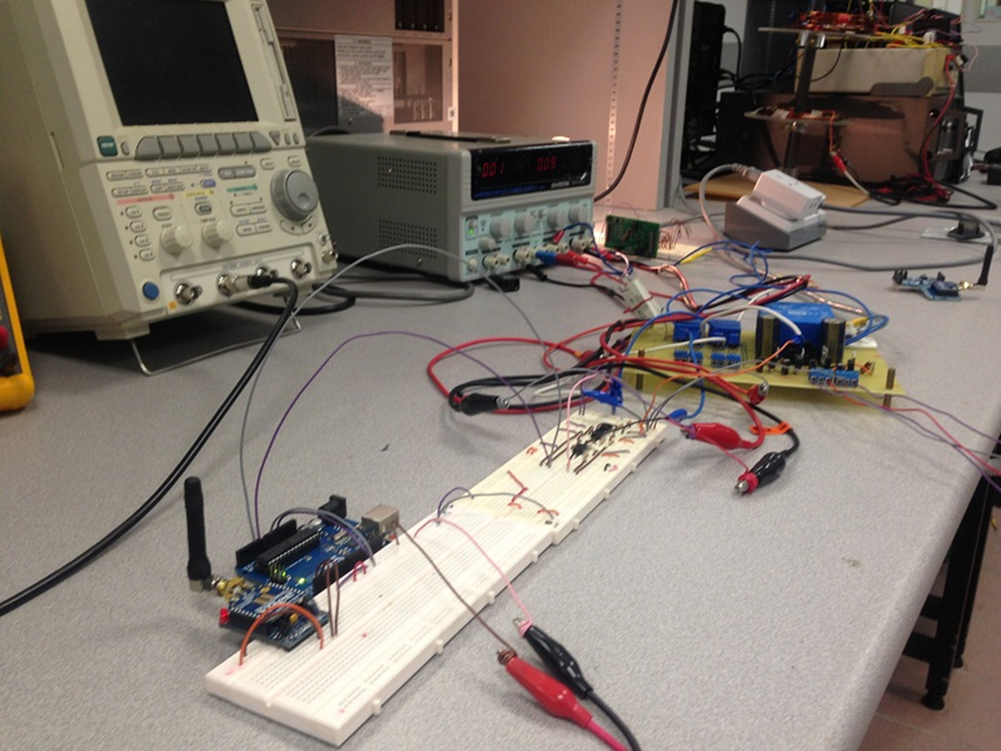
Node 1
Node 1 using Arduino Uno and Xbee S2 wireless board is capturing supply current and voltage from voltage and current transducers connected to a socket which powers a bulb and a CPU fan (not seen in picture)

Slide 50
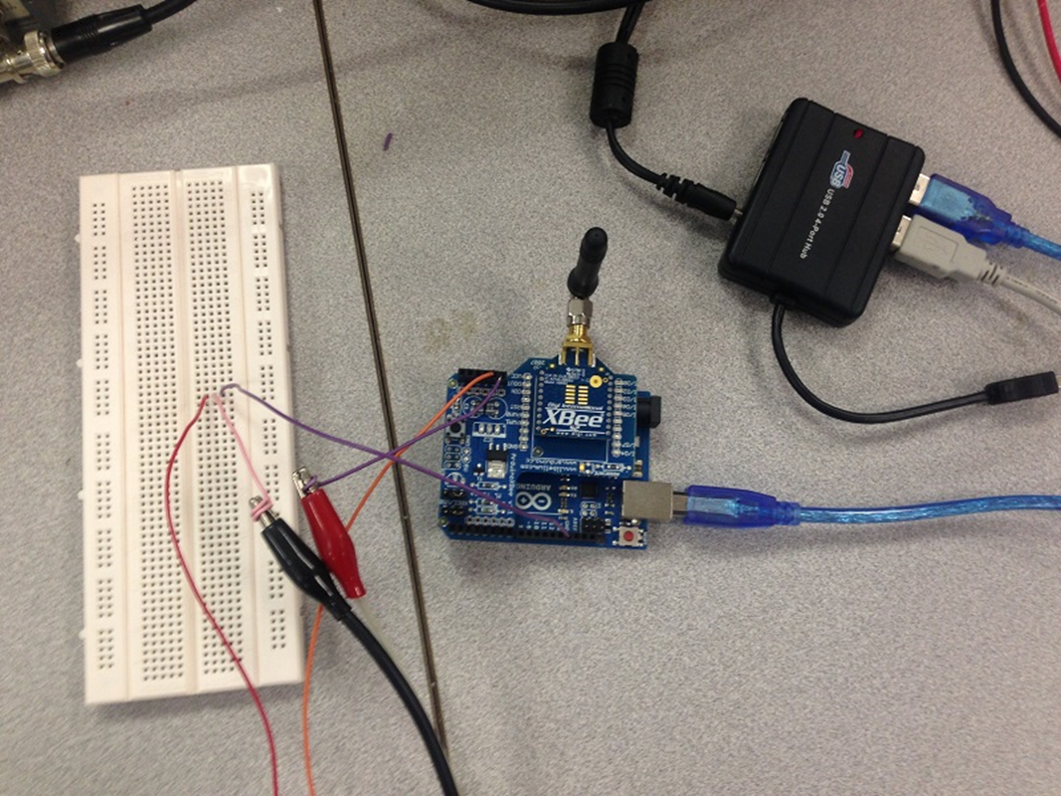
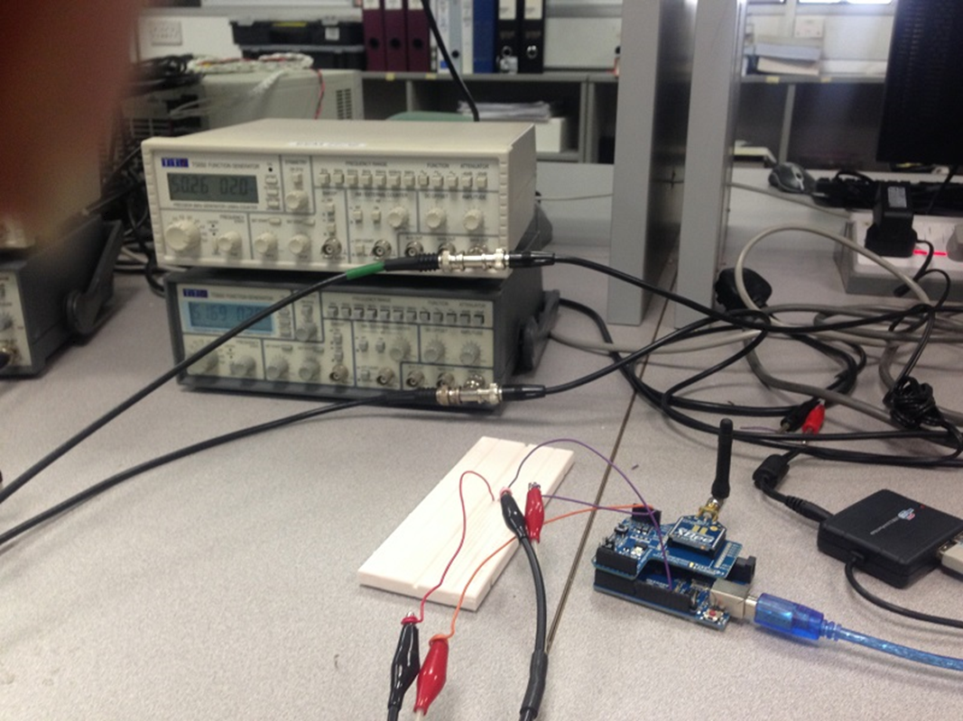
Node 2
Node 2 with the same configuration, but is capturing signals from 2 function generators instead of voltage and current transducer

Slide 51
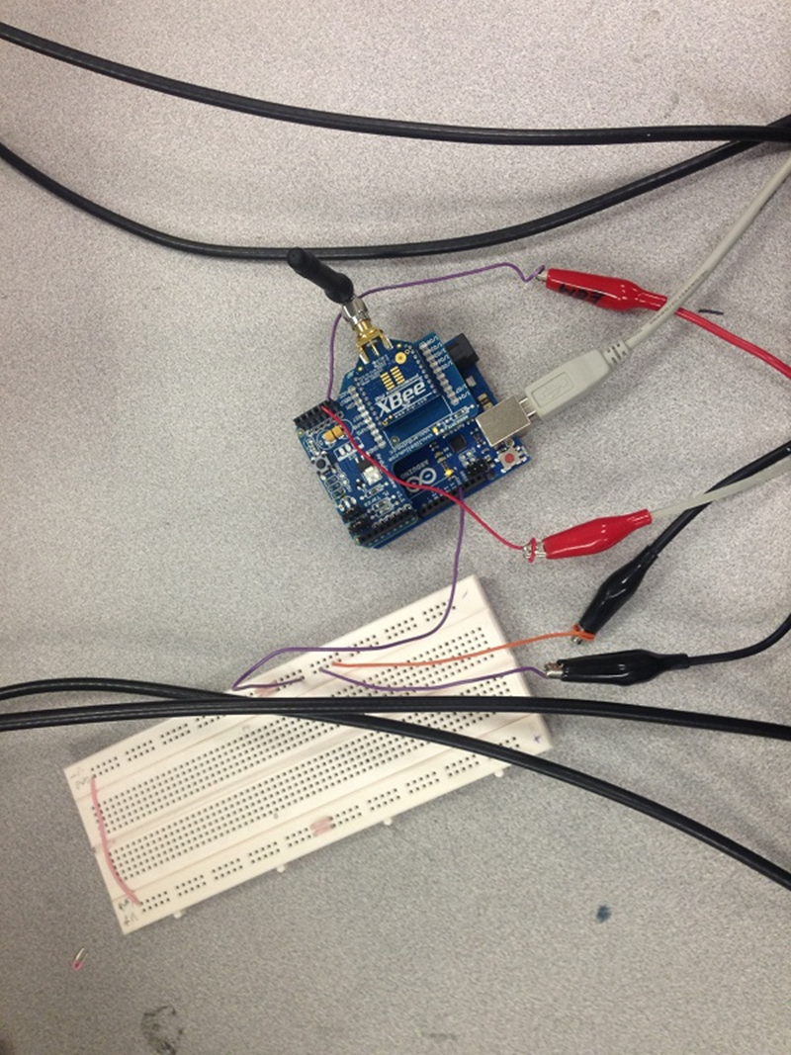
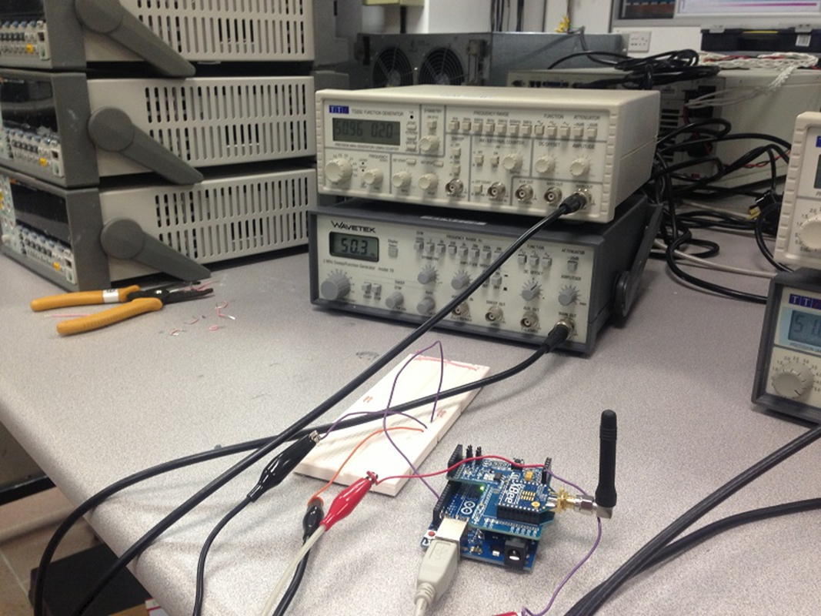
Node 3
Node 3 with the same configuration, and is capturing signals from 2 other function generators instead of voltage and current transducer

Slide 52
End Result
Captured voltage and current signals captured from Node 1, 2 and 3 (at the base station connected to another Xbee S2 module) respectively from top to bottom.
The graphs starting from the left to right denote received voltage, current and calculated power signals. In each case, the calculated average of each quantity is shown on the top of the graph.
The voltage and current samples were received at a rate of 188 samples per second. This plot was displayed by capturing the received samples (which was sent in Xbee ADC packet format) and then displaying it using Processing. Each node sent its own identity information along with the samples so that they could be distinguished from samples from other nodes.

Slide 53
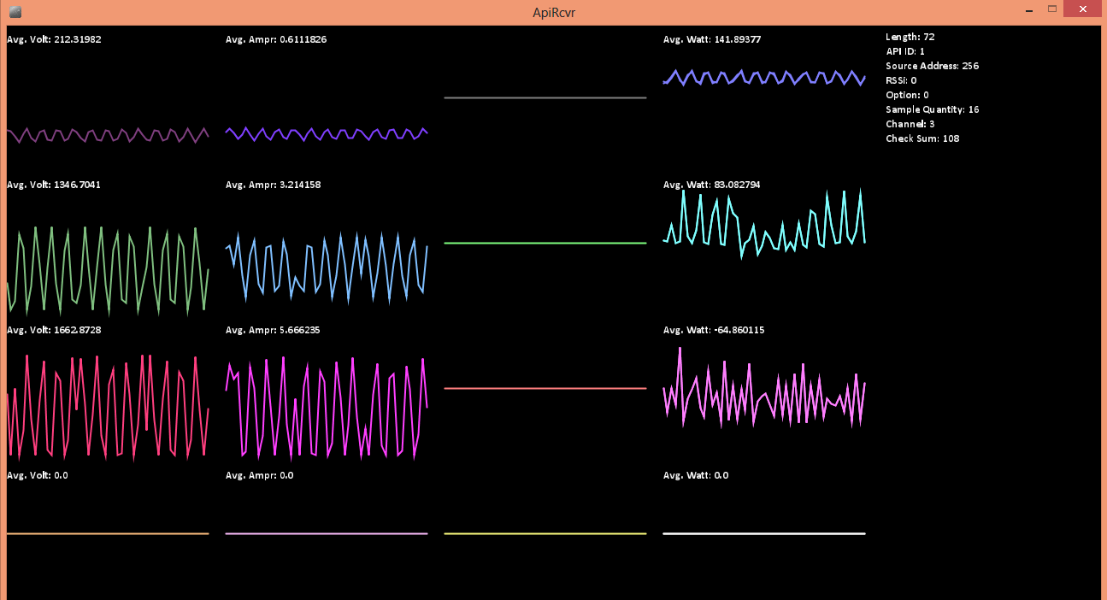
End Result

